Slide 1
OBJECTIVE
Forecasting of retail sales helps retailer to take necessary measures to plan their budgets or investments in a period (monthly, yearly) among different product categories and at the same time they can plan to minimize revenue loss from unavailability of products by investing accordingly.
Trying to get the least RMSE values for the test data

Slide 2
PREDICTORS IN TRAIN DATASET
Year | temporal | Year
Month | temporal | Month
ProductCategory | categorical | Clothing Products category - WomenClothing, MenClothing, OtherClothing
Sales(In ThousandDollars) | numeric | Value of the sales or revenue in thousand dollars

Slide 3
PREDICTORS IN WEATHER DATA
Temp high (°C) | Temperature HighInF | numeric
Temp avg (°C) | Temperature AvgInF | numeric
Temp low (°C) | Temperature LowinF | numeric
Dew Point high (°C) | DewPointHighInF | numeric
Dew Point avg (°C) | DewPointAvginF | numeric
Dew Point low (°C) | DewPointLowinF | numeric
Humidity (%) high | Humidity HighPercent | numeric
Humidity (%) avg | Humidity AvgPercent | numeric
Humidity (%) low | Humidity LowPercent | numeric
Sea Level Press. (hPa) high | Sea Level Pressure High_hPa | numeric
Sea Level Press. (hPa) avg | Sea Level Pressure Avg_hPa | numeric
Sea Level Press. (hPa) low | Sea Level Pressure Low_hPa | numeric
Visibility (km) high | Visibility HighInKM | numeric
Visibility (km) avg | Visibility AvgInKM | numeric
Visibility (km) low | Visibility LowInKM | numeric
Wind (km/h) low | Wind LowInKmperhour | numeric
Wind (km/h) avg | Wind AvgInKmperhour | numeric
Wind (km/h) high | Wind HighInKmperhour | numeric
Precip. (mm) sum | Precipitation sum in mm | numeric values and character
WeatherEvent | Details of weather like snow, rain, fog etc | categorical

Slide 4
PREDICTORS IN MACRO ECONOMIC DATA
Year-Month | Combination of Year and month
Monthly Nominal GDP Index (inMillion$) | Monthly NominalGDPIndex In Million Dollars
Monthly Real GDP Index (inMillion$) | Monthly RealGDPIndex In Million Dollars
CPI | CPI
PartyInPower | Political party which is in power
unemployment rate | unemployment rate
CommercialBankInterestRateonCreditCardPlans | Commercial Bank Interest Rate on Credit Card Plans
Finance Rate on Personal Loans at Commercial Banks, 24 Month Loan | Finance Rate on Personal Loans at Commercial Banks_24MonthLoan
Earnings or wages in dollars per hour | Earningso rwages in dollars per hour
AdvertisingExpenses (in Thousand Dollars) | Expenses for ads in thousand dollars
Cotton Monthly Price - US cents per Pound(lbs) | Cotton Monthly Price_US cents per Pound_lbs
Change(in%) | Percentage Change In Mly Cotton Price
Average upland planted(million acres) | Average upland Cotton planted In Million Acres
Average upland harvested(million acres) | Average upland Cotton harvested In Million Acres
yieldperharvested acre | Cotton yield per harvested acre ( in pounds ie., lbs)
Production (in 480-lb netweright in million bales) | Cotton Production In480_l bnetweight in Million Bales
Mill use (in 480-lb netweright in million bales) | Cotton Mill Use In480_lb netweight in Million Bales
Exports | Cotton Explorts In480_lb netweight in Million Bales

Slide 5
EDA

Slide 6
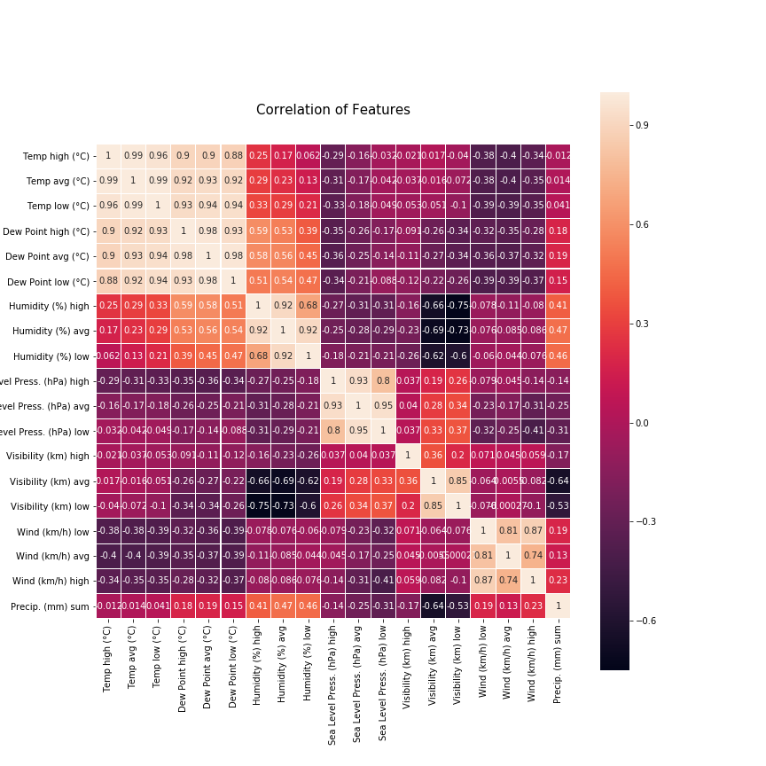

Slide 7
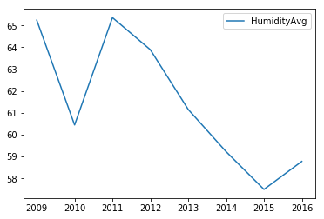
AVG HUMIDITY VS YEAR

Slide 8
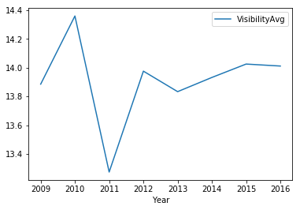
AVG VISIBILITY VS YEAR

Slide 9
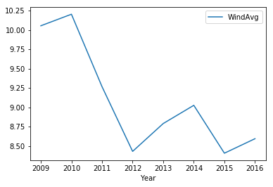
WINDAVG VS YEAR

Slide 10
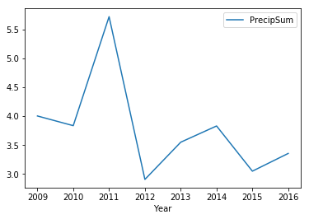
PRECIPITATESUM VS YEAR

Slide 11
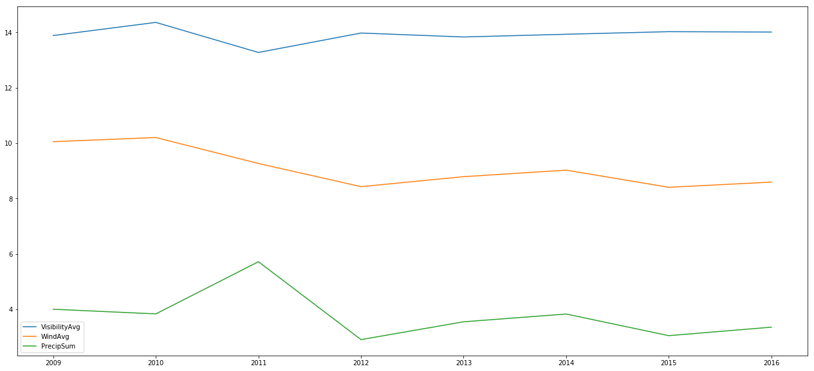
VISIBILITY/WIND/PRECIPITATION WITH PASSING YEARS

Slide 12
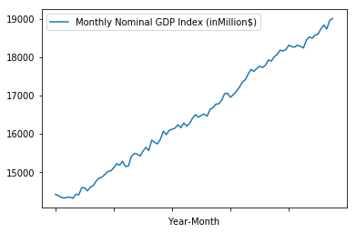
MONTHLY NOMINAL GDP

Slide 13
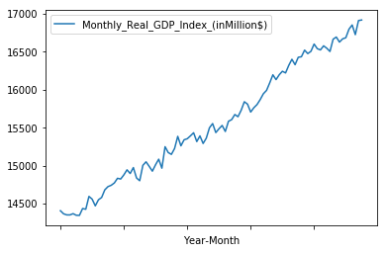
MONTHLY REAL GDP

Slide 14
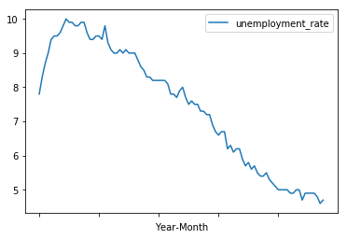
UNEMPLYEMENT RATE WITH YEAR-MONTH

Slide 15
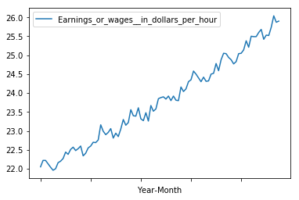
EARNINGS VS YEAR-MONTH

Slide 16
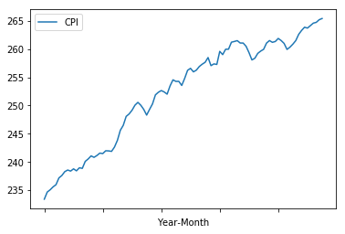
CPI VS YEAR-MONTH

Slide 17
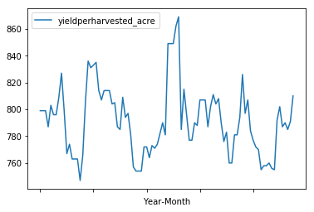
YIELD HARVESTED VS YEAR-MONTH

Slide 18
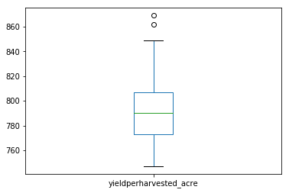
BOXPLOT ON YIELDPERHARVESTED

Slide 19
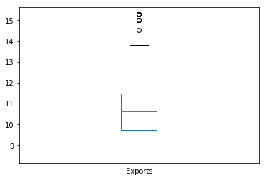
OUTLIERS IN EXPORTS

Slide 20
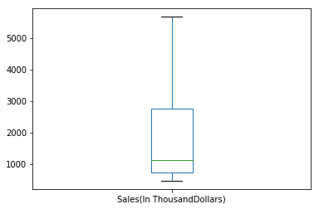
SALES BOXPLOT

